Slide 1
National Health and Nutrition Examination Survey Analysis
Team #68
MGT6203
November 15, 2022

Slide 2
Outline
Project overview
Team members
Background
Data Overview
Source and Data Cleaning
Key Variables
Modeling Overview
Feature Section
Model Used
Hyperparameter Optimization
Model Performance
Overview
Hypothesis
Feature Engineering
EDA
Model Comparison
Model Selection

Slide 3

Overview: Team #68 Members
Gabriel Mink: gmink3@gatech.edu
Bella (Yifei) Ding: yding302@gatech.edu
Vincent Pan: vipan@gatech.edu
Nikolos Lahanis: nlahanis3@gatech.edu
Rahul Sati: rsati3@gatech.edu

Slide 4

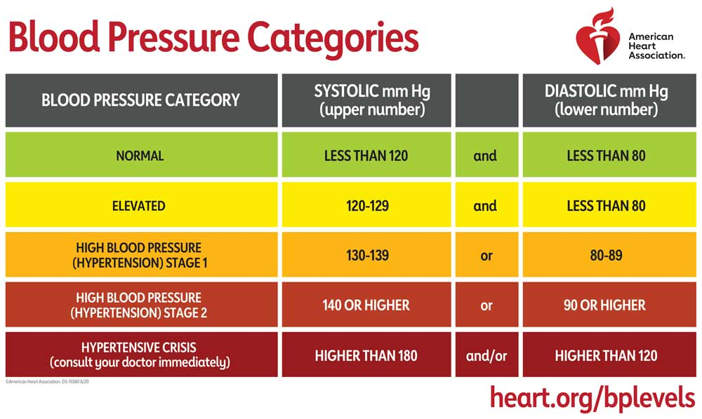
Overview: Background
According to the World Health Organization, ¹ “the number of adults living with elevated levels of blood pressure known as “Hypertension” has doubled since 1990 to 1.28 Billion as of August 25, 2021.
Blood pressure categories used to engineer our response variable were taken from the “American Heart Association’s” ² categorizations.
Can we use this synthesized response variable to draw any meaningful insights about circumstances that lead to high blood pressure?

Slide 5
Overview
Problem - What health factors may correlate and predict an elevated level of blood pressure in American society?
Approach - Using data provided by the National Health and Nutrition Examination Survey, our intent is to analyze various factors association with blood pressure, including: Demographics, Diet, Lab Test Info, Medications, and Doctor’s Exam Answers.

Slide 6
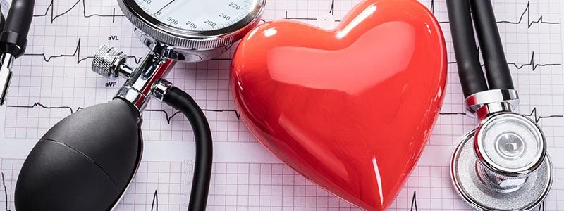
Overview: Hypothesis
Patients in our dataset that are identified to be obese & have a high sodium intake will also have hypertension

Slide 7
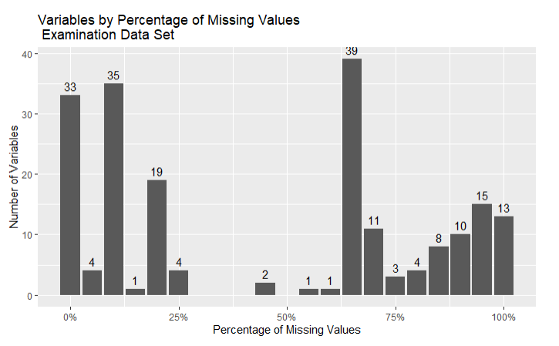

Data: Data Source and Cleaning
Original Data Sets
Data Cleaning Methods
Data/ Entry Selection
Response variable existance
Feature Creation/ Mutation
Missing Data Handling
Drop: e.g. sometimes Mode doesn’t make sense
Imputation: Median, Mode
Feature Summarizing
Summarizing the categorization of thirty different teeth into counts of the quality
Feature Selection Part 1 (Part 2 in next slide)
Sparse Feature Removal
Related Response Feature Removal
Blood Pressure Measurement Features
Unrelated Feature Removal
E.g. Whether an interpreter conducted the interview
Original Total Variables: 1.8k
Resulting Total Variables: 152
Demographics Data Set: 47 Variables
Diet Data Set: 168 Variables
Labs Data Set: 224 Variables
Questionnaire Set: 953 Variables
Examinations Data Set: 424 Variables
Medication Data Set: 13 Variables
Examinations Data:
Distribution of Columns by the Percentage of Missing Values in the Column
(e.g. 13 variables had 95%+ missing values)
Dataset Source
Notes:
Thanks Niko,
On this slide I’m going to go over Data Cleaning
On the left I’ve have an overview of the data sets that we started out with.
Our data set started with over one point eight thousand variables across the 6 data sets.
To ensure that data was consistent and usable, we had a do a few things.
For example,
we had to filter out the rows that didn’t have our response for the model building, and
We had to think about how to handle columns with missing data, and also rows with missing data.
The chart in the middle is a snapshot of the Examination data set, and
how the columns are distributed based on their percentage of missing data. If the column was too sparse,we removed it.
We also summarized and removed some of the unrelated features to reduce the total number of variables to one hundred and fifty two.

Slide 8
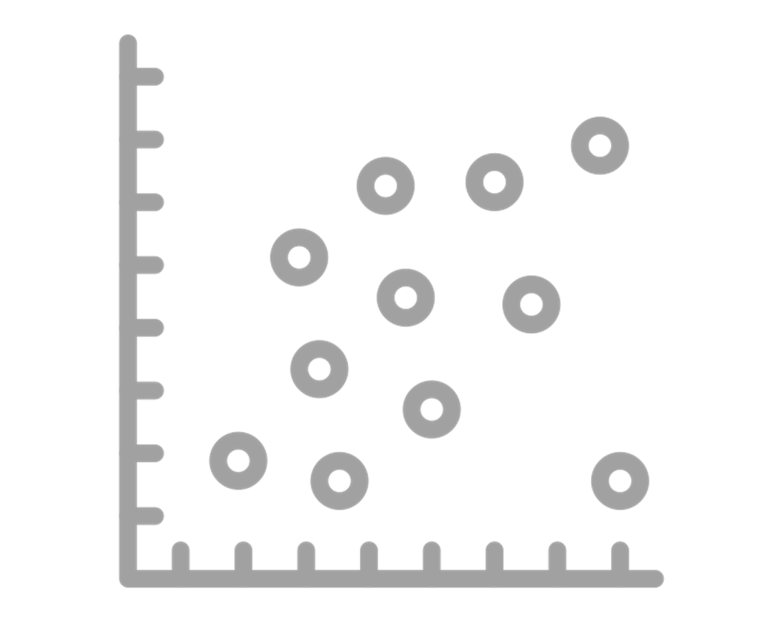
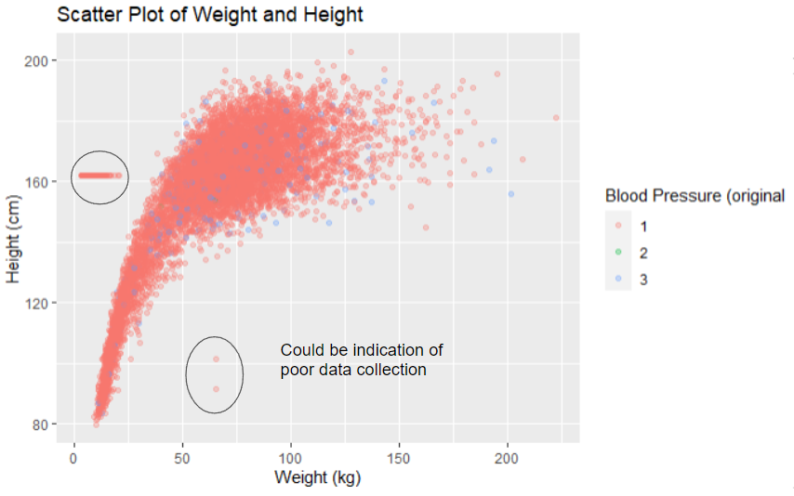
Data: EDA and Key Variables
EDA
Key Variables
In addition to selecting features by removing Features
With Sparse Rows;
Directly Related to the Response, and
Unrelated to the Response (see prev. slide),
below are some of the additional methods we attempted while doing EDA
Plots and additional Data Issues
Additional plots to investigate and understand the data was done to develop a sense of intuition between the variables.
Our team’s research on what is linked to elevated blood pressure encompassed medical websites and journals such as cdc.gov, mayoclinic.org, and a research paper from the journal of the American College of Cardiology.
From those sources, we hypothesized weight, age, high sodium diet, and alcohol consumption would all be predictive factors
Significant Variables from Preliminary Model:
BMXWT: Weight (kg)
LDBTCSI: Total Cholesterol (mmol/L)
RIAGENDR: Gender of Participant
RIDAGEYR: Age of Participant (Years)
Example of Plot on a sample of variables of our Data
As expected, as height increases, weight generally increases. However it is not a perfectly linear relationship.
We observe a few data points that share the same height around the 161 cm mark, and the 60 kg mark. This could be an indication of some data accuracy issue.
Notes:
Since starting on the project, the team has gone through a bit of work.
We had to understand the data, as well as the domain. Even understanding that Blood Pressure was a combination of two measurements was new to a few of us.
The EDA that we did is discussed in our progress reports. But some of the highlights that we looked into to help ensure that our data won’t have too many issues when we start modelling, include looking at the correlations of our variables and the variance inflation factors of them.
We also ran an initial model this week
We used a logistic regression and found that Weight, Gender, Age, and Cholesterol are significant features,
and in terms of performance, the model had 76.76% accuracy, and a ROC of 84.15. In the slide we have the ROC curve on the right for your reference.

Slide 9

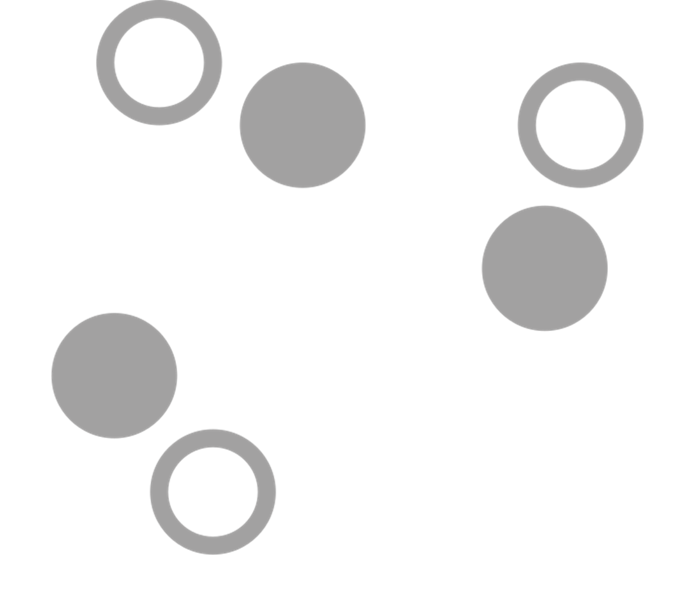
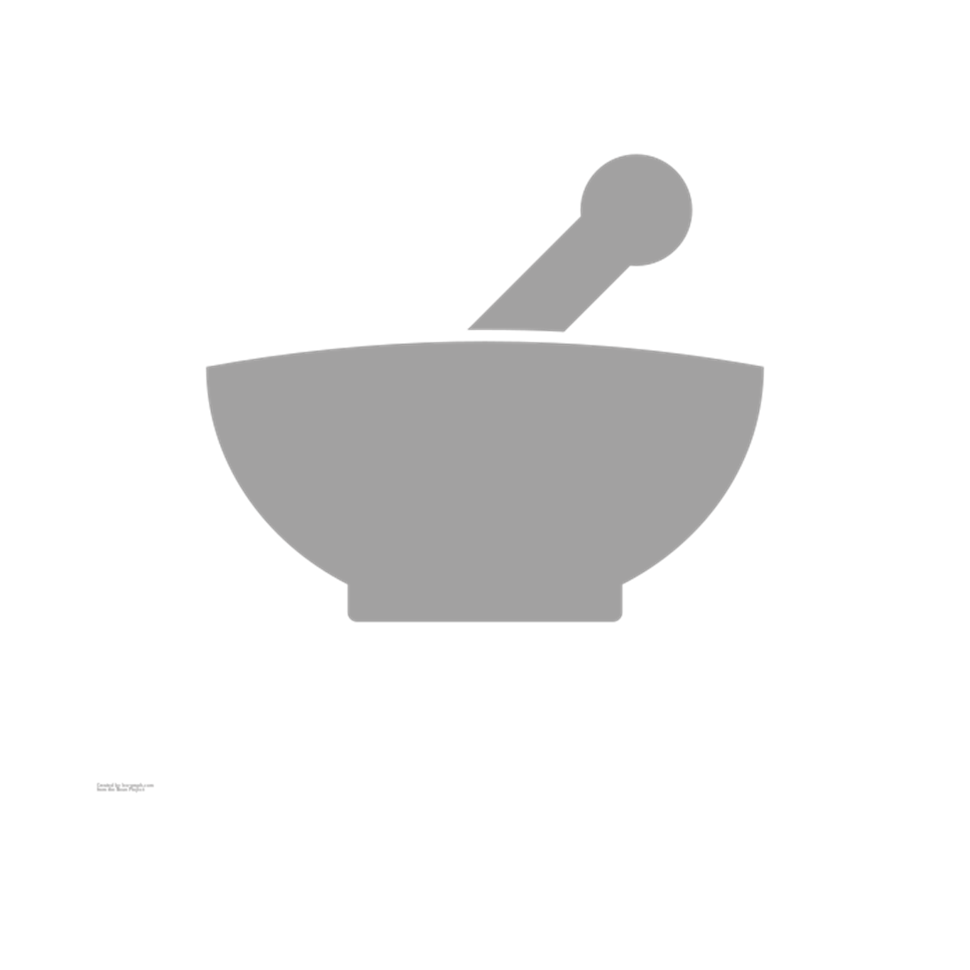
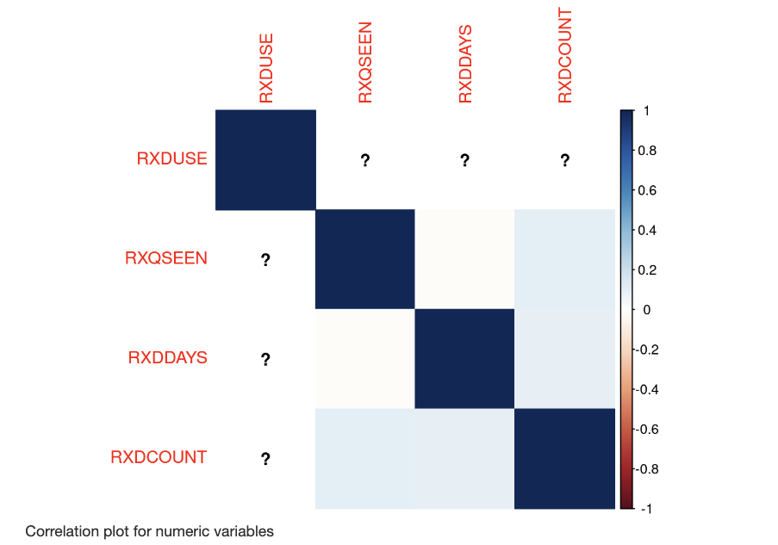
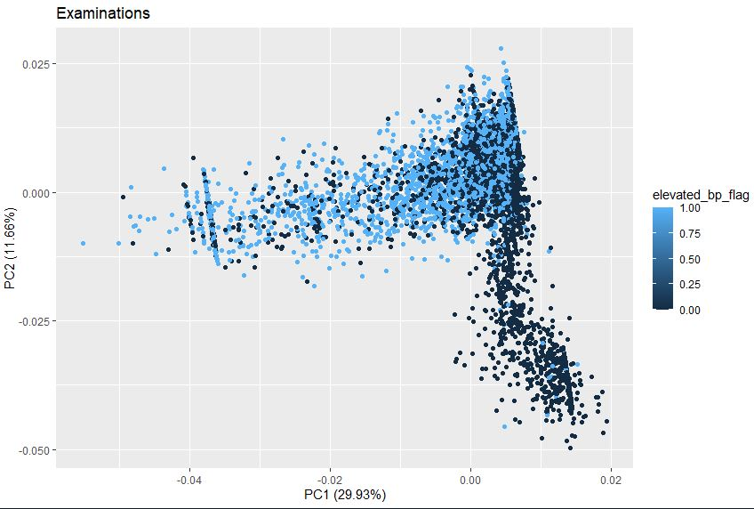
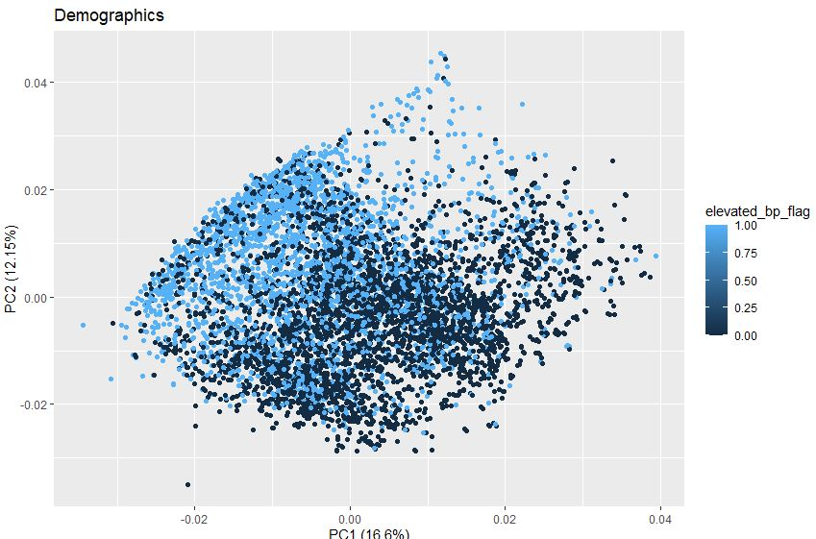
Data: EDA, Feature Engineering, and Feature Selection
Feature Engineering and Feature Selection
Correlation and Variance Inflation Factor (VIF)
Correlation plots were created in many of the data sets to gain a quick understanding of what the data set included. This combined with running a VIF allowed us to identify variables to treat/ remove (especially to reduce multicollinearity)
Logging Variables and Aggregating Variables
We tried to log data and aggregate similar variables to create new variables.
One example is that we had whether a single tooth was health, missing, filled, etc. Instead of having 32 separate columns (as per original data), we summarized it into a few columns that counted how many were healthy, how many were filled etc. The quality of these variables is understood in the Modelling section
PCAs
PCAs were run on each of the sub data sets to see if we could create new variables that reduce the dimensions of the data set
Example of Correlation Plot on a sample of variables of our Data
Variables RXQSEEN is positively correlated with RXDDAY and RXDCOUNT.
This helped us understand groups of variables intuitively rather than one by one.
RXQSEEN is a flag that indicates whether a Medicine container was seen by the interviewer, RXDDAYS was the number of days taken medicine, and RXDCOUNT is the number of medication. Intuitively it makes sense
Example of PCA on Examination Data Set.
We can see on the bottom right that there is a cluster of similarly colored datapoints
Example of PCA on Demographic Data Set.
It looks like a soft margin SVM could be used on Demographics or Diet PCA to get a quick result
Notes:
Since starting on the project, the team has gone through a bit of work.
We had to understand the data, as well as the domain. Even understanding that Blood Pressure was a combination of two measurements was new to a few of us.
The EDA that we did is discussed in our progress reports. But some of the highlights that we looked into to help ensure that our data won’t have too many issues when we start modelling, include looking at the correlations of our variables and the variance inflation factors of them.
We also ran an initial model this week
We used a logistic regression and found that Weight, Gender, Age, and Cholesterol are significant features,
and in terms of performance, the model had 76.76% accuracy, and a ROC of 84.15. In the slide we have the ROC curve on the right for your reference.

Slide 10
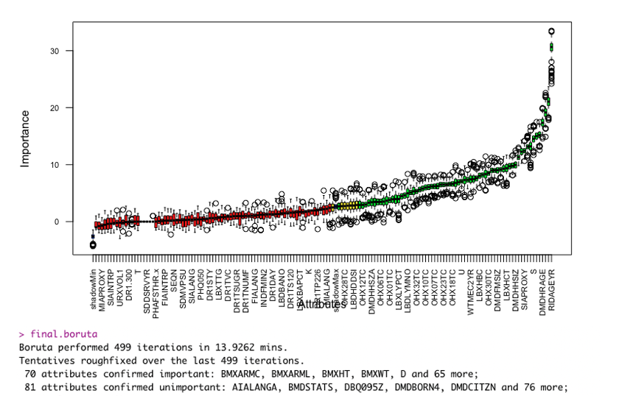
Modeling: Feature Selection
Feature Selection Techniques
Original Total Variables: 1.8k
Variables Prior to this Step: 151
Final Model Number of Variables: 70
Elastic Net Regression
Elastic Net Regression was run to enhanced the reliability of our predictive models to focus on only the most significant predictable features
Using Elastic Net Regression, the total number of features in our model reduced by a further 35%, while only keeping the ones with the most significant predictive ability.
Boruta algorithm
The Boruta algorithm is a wrapper built around the random forest classification algorithm. Basically, randomly shuffled shadow attributes are defined to establish a baseline performance for prediction against the target variable.
Then a hypothesis test is used to determine, with a certain level of risk (0.05 by default) if each variable is correlated only randomly. Variables that fail to be rejected are removed from consideration.
Notes:
Thanks Niko,
On this slide I’m going to go over Data Cleaning
On the left I’ve have an overview of the data sets that we started out with.
Our data set started with over one point eight thousand variables across the 6 data sets.
To ensure that data was consistent and usable, we had a do a few things.
For example,
we had to filter out the rows that didn’t have our response for the model building, and
We had to think about how to handle columns with missing data, and also rows with missing data.
The chart in the middle is a snapshot of the Examination data set, and
how the columns are distributed based on their percentage of missing data. If the column was too sparse,we removed it.
We also summarized and removed some of the unrelated features to reduce the total number of variables to one hundred and fifty two.

Slide 11



Modeling: Models Used
Logistic Regression
Random Forest
XGBoost
1
2
3
Notes:
Thanks Niko,
On this slide I’m going to go over Data Cleaning
On the left I’ve have an overview of the data sets that we started out with.
Our data set started with over one point eight thousand variables across the 6 data sets.
To ensure that data was consistent and usable, we had a do a few things.
For example,
we had to filter out the rows that didn’t have our response for the model building, and
We had to think about how to handle columns with missing data, and also rows with missing data.
The chart in the middle is a snapshot of the Examination data set, and
how the columns are distributed based on their percentage of missing data. If the column was too sparse,we removed it.
We also summarized and removed some of the unrelated features to reduce the total number of variables to one hundred and fifty two.

Slide 12
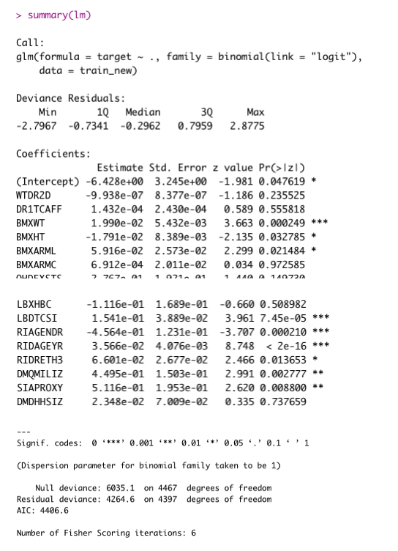
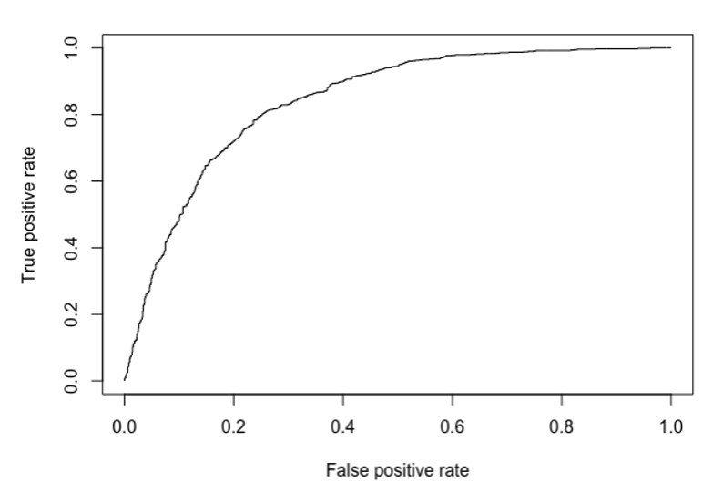
Modeling: Model 1: Logistic Regression
Summary
Initial Model ran with a logistic regression (with p>0.5 then 1 else 0)
Performance
Key Variables and Cross Validation
Significant Variables:
BMXWT: Weight (kg)
LDBTCSI: Total Cholesterol (mmol/L)
RIAGENDR: Gender of Participant
RIDAGEYR: Age of Participant (Years)
ROC chart with False Positive Rate on the X-axis, and True Positive Rate of our Logistic Regression on the Y
Cross Validation:
Accuracy: 76.76%
Accuracy: 75.88%
AUC: 84.15
Notes:
But getting there, We also faces quite a few road bumps. For example, we had started with a lot of variables, and some of the variable were tricky when it came to understanding the correlations.
I’ve listed the causes and the solutions in the slide, but just to dive into one as an example,
when we decided to model Blood Pressure, the data set already had a Blood Pressure response column. However, we found that it was highly imbalanced variable of High Hypertension.
Luckily, the data set also had the measurements that calculates Blood Pressure.
So we constructed a new response (Normal Blood Pressure vs Elevation). And that was much more balanced.
Looking forward, our team is excited to try additional models, use what we have learnt in the course, such as needing a train, validation, test split, and do further transformations.
That is all from our team!
Thanks for listening

Slide 13
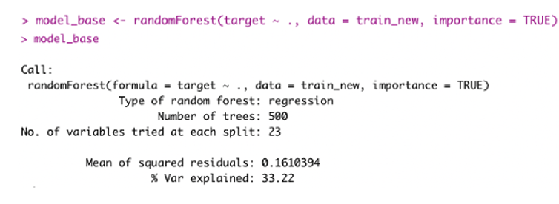
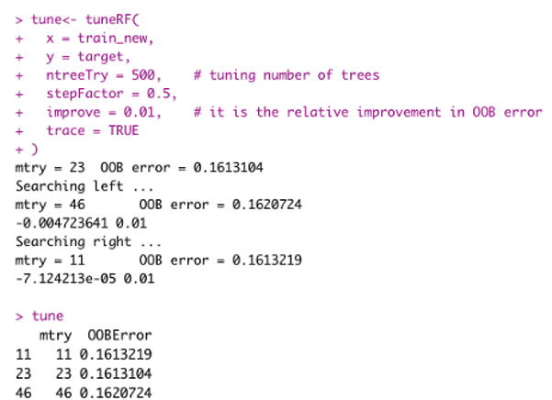
Modeling: Model 2: Random Forest
Summary
Performance
Key Variables and Cross Validation
Significant Variables:
BMXWT: Weight (kg)
BMXARMC: Arm Circumference (cm)
BMXARML: Upper Arm Length (cm)
RIAGENDR: Gender of Participant
RIDAGEYR: Age of Participant (Years)
URDACT: Albumin creatinine ratio (mg/g)
Default Parameters:
Accuracy: 77.65%
AUC: 84.29
Default Parameters had 500 Trees, and 23 splits
Tuned Model:
Cross Validation:
Accuracy: 77.81%
Accuracy: 77.33%
AUC: 84.28
Hyperparameter tuning
Notes:
But getting there, We also faces quite a few road bumps. For example, we had started with a lot of variables, and some of the variable were tricky when it came to understanding the correlations.
I’ve listed the causes and the solutions in the slide, but just to dive into one as an example,
when we decided to model Blood Pressure, the data set already had a Blood Pressure response column. However, we found that it was highly imbalanced variable of High Hypertension.
Luckily, the data set also had the measurements that calculates Blood Pressure.
So we constructed a new response (Normal Blood Pressure vs Elevation). And that was much more balanced.
Looking forward, our team is excited to try additional models, use what we have learnt in the course, such as needing a train, validation, test split, and do further transformations.
That is all from our team!
Thanks for listening

Slide 14
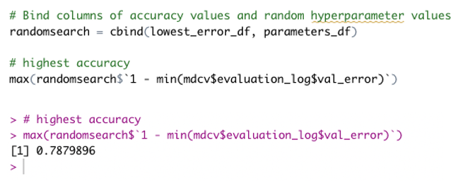
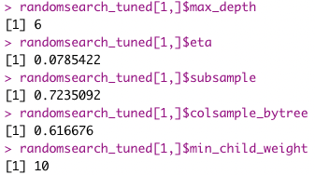
Modeling: Model 3: XGBoost
Summary
Performance
Key Variables
Significant Variables:
BMXWT: Weight (kg)
BMXARMC: Arm Circumference (cm)
BMXHT: Standing Height (cm)
RIAGENDR: Gender of Participant
RIDAGEYR: Age of Participant (Years)
URDACT: Albumin creatinine ratio (mg/g)
Default Parameters:
Accuracy: 76.76%
AUC: 83.61
Tuned Model:
Accuracy: 78.79%
AUC: 84.31
Hyperparameter tuning
Notes:
But getting there, We also faces quite a few road bumps. For example, we had started with a lot of variables, and some of the variable were tricky when it came to understanding the correlations.
I’ve listed the causes and the solutions in the slide, but just to dive into one as an example,
when we decided to model Blood Pressure, the data set already had a Blood Pressure response column. However, we found that it was highly imbalanced variable of High Hypertension.
Luckily, the data set also had the measurements that calculates Blood Pressure.
So we constructed a new response (Normal Blood Pressure vs Elevation). And that was much more balanced.
Looking forward, our team is excited to try additional models, use what we have learnt in the course, such as needing a train, validation, test split, and do further transformations.
That is all from our team!
Thanks for listening

Slide 15

Modeling: Models Used
Logistic Regression
Random Forest
XGBoost
1
2
3
Accuracy: 76.76%
Accuracy: 77.81%
Accuracy: 78.79%
AUC: 84.15
AUC: 84.28
AUC: 84.31
Notes:
Thanks Niko,
On this slide I’m going to go over Data Cleaning
On the left I’ve have an overview of the data sets that we started out with.
Our data set started with over one point eight thousand variables across the 6 data sets.
To ensure that data was consistent and usable, we had a do a few things.
For example,
we had to filter out the rows that didn’t have our response for the model building, and
We had to think about how to handle columns with missing data, and also rows with missing data.
The chart in the middle is a snapshot of the Examination data set, and
how the columns are distributed based on their percentage of missing data. If the column was too sparse,we removed it.
We also summarized and removed some of the unrelated features to reduce the total number of variables to one hundred and fifty two.

Slide 16
Conclusion
Summary of Approach and Key Findings - This project started with an initial hypothesis based on current research that weight, age, high sodium diet, and alcohol consumption were not only correlated but could be predictive of elevated blood pressure levels. After extensive pre-processing of the Nutritional Health and Examination data set, involving PCA feature reduction, sparsity elimination, factorization, and several engineered additional features, as final data set was created in order to predict blood pressure using a suite of predictive classifiers, XGB, Random Forest, and Logistic regression. The feature importances of these models confirm some of the initial hypothesis. Weight and age appeared at the top of nearly all of our models, in addition to several other surprising features such as Albumin Creatine, which when further researched⁷ was noted as being related to hypertension.
Final Model and Next Steps - With an overall accuracy of 78.8% using a tuned XGB model, on a nearly balanced data set, it can be said with a degree of confidence that the model was a useful endeavour. It is hoped that this research serves as a jumping off point for further predictive analytic work in the space of nutrition and healthcare in order to prescribe preventative measures and additional insights as to potential correlative factors further upstream of a physical blood pressure test.

Slide 17
Key Sources
https://www.who.int/news/item/25-08-2021-more-than-700-million-people-with-untreated-hypertension
https://www.heart.org/en/health-topics/high-blood-pressure/understanding-blood-pressure-readings
https://www.ahajournals.org/doi/10.1161/CIR.0000000000000973
https://www.ncbi.nlm.nih.gov/pmc/articles/PMC6770596/
https://www.slidescarnival.com/extra-free-resources-icons-and-maps

